Slide 6
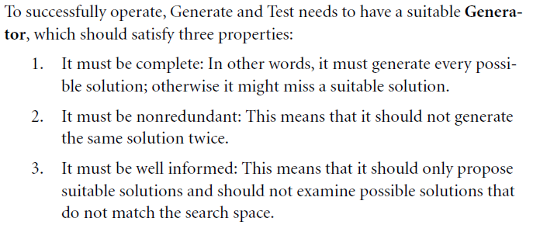

Slide 8
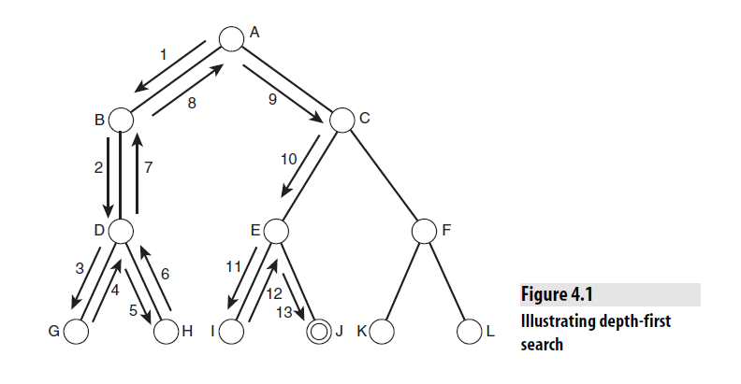

Slide 9
Depth-First Strategy
New nodes are inserted at the front of FRINGE
1
2
3
FRINGE = (2, 3)
4
5

Slide 10
Depth-First Strategy
New nodes are inserted at the front of FRINGE
1
2
3
FRINGE = (4, 5, 3)
4
5

Slide 11
Depth-First Strategy
New nodes are inserted at the front of FRINGE
1
2
3
4
5

Slide 12
Depth-First Strategy
New nodes are inserted at the front of FRINGE
1
2
3
4
5

Slide 13
Depth-First Strategy
New nodes are inserted at the front of FRINGE
1
2
3
4
5

Slide 14
Depth-First Strategy
New nodes are inserted at the front of FRINGE
1
2
3
4
5

Slide 15
Depth-First Strategy
New nodes are inserted at the front of FRINGE
1
2
3
4
5

Slide 16
Depth-First Strategy
New nodes are inserted at the front of FRINGE
1
2
3
4
5

Slide 17
Depth-First Strategy
New nodes are inserted at the front of FRINGE
1
2
3
4
5

Slide 18
Depth-First Strategy
New nodes are inserted at the front of FRINGE
1
2
3
4
5

Slide 19
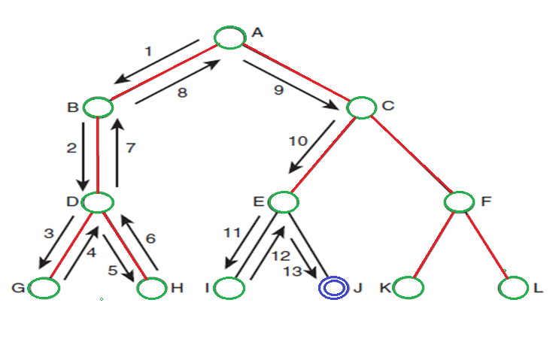
Depth-First Search

Slide 20
Depth-First Search
As anyone who has used the find operation on their computer will know, depth-first search can run into problems. In particular, if a branch of the search tree is extremely large, or even infinite, then the search algorithm will spend an inordinate amount of time examining that branch, which might never lead to a goal state.

Slide 21
Breadth-First Search
An alternative to depth-first search is breadth-first search.
As its name suggests, this approach involves traversing a tree by breadth rather than by depth. As can be seen from next slide, the breadth-first algorithm starts by examining all nodes one level (sometimes called one ply) down from the root node.

Slide 22
Breadth-First Search
If a goal state is reached here, success is reported. Otherwise, search continues by expanding paths from all the nodes in the current level down to the next level. In this way, search continues examining nodes in a particular level, reporting success when a goal node is found, and reporting failure if all nodes have been examined and no goal node has been found.

Slide 23
Breadth-First Strategy
New nodes are inserted at the end of FRINGE
1
2
3
FRINGE = (1)
4
5
6
7

Slide 24
Breadth-First Strategy
New nodes are inserted at the end of FRINGE
1
2
3
FRINGE = (2, 3)
4
5
6
7

Slide 25
Breadth-First Strategy
New nodes are inserted at the end of FRINGE
1
2
3
FRINGE = (3, 4, 5)
4
5
6
7

Slide 26
Breadth-First Strategy
New nodes are inserted at the end of FRINGE
1
2
3
FRINGE = (4, 5, 6, 7)
4
5
6
7

Slide 27
Breadth-First Search
Breadth-first search is a far better method to use in situations where the tree may have very deep paths, and particularly where the goal node is in a shallower part of the tree.
It does not perform so well where the branching factor of the tree is extremely high, such as when examining game trees for games like Go or Chess.
Breadth-first search is a poor idea in trees where all paths lead to a goal node with similar length paths. In situations such as this, depth-first search would perform far better because it would identify a goal node when it reached the bottom of the first path it examined.

Slide 28
Comparison between Depth-First and Breadth-First Search
Depth-first search is usually simpler to implement than breadth-first search.
It usually requires less memory usage because it only needs to store information about the path it is currently exploring, whereas breadth-first search needs to store information about all paths that reach the current depth.
This is one of the main reasons that depth-first search is used so widely to solve everyday computer problems.

Slide 29
Infinite path
The problem of infinite paths can be avoided in depth-first search by applying a depth threshold. This means that paths will be considered to have terminated when they reach a specified depth. This has the disadvantage that some goal states (or, in some cases, the only goal state) might be missed but ensures that all branches of the search tree will be explored in reasonable time. This technique is often used when examining game trees.

Slide 30
Properties of Search Methods
Different search methods perform in different ways. There are several important properties that search methods should have in order to be most useful.
■ Complexity
■ Completeness
■ Optimality
■ Admissibility
■ Irrevocability

Slide 31
Complexity
In discussing a search method, it is useful to describe how efficient that method is, over time and space. The time complexity of a method is related to the length of time that the method would take to find a goal state.
The space complexity is related to the amount of memory that the method needs to use.
It is normal to use Big-O notation to describe the complexity of a method. For example, breadth-first search has a time complexity of O(b^{d}), where b is the branching factor of the tree, and d is the depth of the goal node in the tree

Slide 32
Complexity
Depth-first search is very efficient in space because it only needs to store information about the path it is currently examining, but it is not efficient in time because it can end up examining very deep branches of the tree.

Slide 33
Complexity
Clearly, complexity is an important property to understand about a search method. A search method that is very inefficient may perform reasonably well for a small test problem, but when faced with a large real-world problem, it might take an unacceptably long period of time. As we will see, there can be a great deal of difference between the performance of two search methods, and selecting the one that performs the most efficiently in a particular situation can be very important.

Slide 34
Complexity
This complexity must often be weighed against the adequacy of the solution generated by the method.
A very fast search method might not always find the best solution, whereas, for example, a search method that examines every possible solution will guarantee to find the best solution, but it will be very inefficient

Slide 35
Completeness
A search method is described as being complete if it is guaranteed to find a goal state if one exists.
Breadth-first search is complete, but depth-first search is not because it may explore a path of infinite length and never find a goal node that exists on another path.

Slide 36
Completeness
Completeness is usually a desirable property because running a search method that never finds a solution is not often helpful.
A method that is not complete has the disadvantage that it cannot necessarily be believed if it reports that no solution exists.

Slide 37
Optimality
A search method is optimal if it is guaranteed to find the best solution that exists. In other words, it will find the path to a goal state that involves taking the least number of steps.
This does not mean that the search method itself is efficient—it might take a great deal of time for an optimal search method to identify the optimal solution—but once it has found the solution, it is guaranteed to be the best one.

Slide 38
Optimality
Breadth-first search is an optimal search method, but depth-first search is not. Depth-first search returns the first solution it happens to find, which may be the worst solution that exists. Because breadth-first search examines all nodes at a given depth before moving on to the next depth, if it finds a solution, there cannot be another solution before it in the search tree.
In some cases, the word optimal is used to describe an algorithm that finds a solution in the quickest possible time, in which case the concept of admissibility is used in place of optimality. An algorithm is then defined as admissible if it is guaranteed to find the best solution.

Slide 39
Irrevocability
Methods that use backtracking are described as tentative.
Methods that do not use backtracking, and which therefore examine just one path, are described as irrevocable.(ˌiˈrevəkəbə)
Depth-first search is an example of tentative search.
Irrevocable search methods will often find suboptimal solutions to problems because they tend to be fooled by local optima-solutions that look good locally but are less favorable when compared with other solutions elsewhere in the search space.

Slide 40
Why Humans Use Depth-First Search?
Depth-first search is somewhat easier.
It is also somewhat easier for humans to understand because it much more closely relates to the natural way in which humans search for things, as we see in the following two examples.

Slide 41
Example : Traversing a Maze
When traversing a maze, most people will wander randomly, hoping they will eventually find the exit.
This approach will usually be successful eventually but is not the most rational and often leads to what we call “going round in circles.”
This problem relates to search spaces that contain loops, and it can be avoided by converting the search space into a search tree.

Slide 42
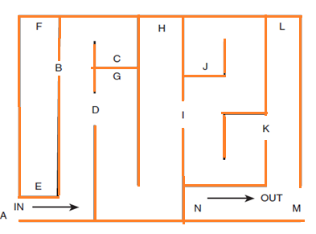

Slide 43
Traversing a Maze
An alternative method is:
To start with your hand on the left side of the maze (or the right side, if you prefer).
Follow the maze around, always keeping your left hand on the left edge of the maze wall.
In this way, you are guaranteed to find the exit. This is because this technique corresponds exactly to depth-first search.

Slide 44
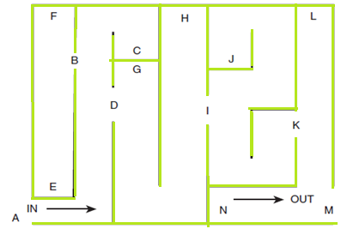
Certain special points in the maze have been labeled:
■ A is the entrance to the maze.
■ M is the exit from the maze.
■ C, E, F, G, H, J, L, and N are dead ends.
■ B, D, I, and K are points in the maze where a choice can be made as to which direction to go next.

Slide 45
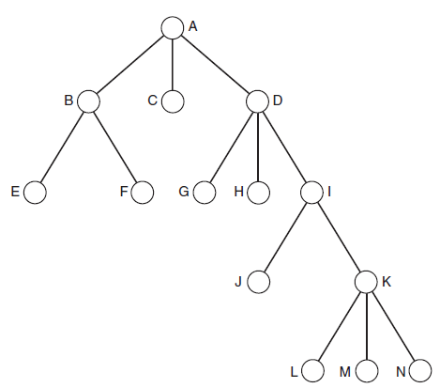
In following the maze by running one’s hand along the left edge, the following path would be taken:
A, B, E, F, C, D, G, H, I, J, K, L,M

Slide 46
Traversing a Maze
You should be able to see that following the search tree using depth-first search takes the same path. This is only the case because the nodes of the search tree have been ordered correctly. The ordering has been chosen so that each node has its left-most child first and its right-most child last.
Using a different ordering would cause depth-first search to follow a different path through the maze.

Slide 48
Implementing Depth-First and Breadth-First Search
The variable state represents the current state at any given point in the algorithm, and queue is a data structure that stores a number of states, in a form that allows insertion and removal from either end. In this algorithm, we always insert at the front and remove from the front
In this implementation, we have used the function successors (state),which simply returns all successors of a given state.

Slide 49
Function depth ()
{
queue = []; // initialize an empty queue
state = root_node; // initialize the start state
while (true)
{
if is_goal (state)
then return SUCCESS
else
add_to_front_of_queue (successors (state));
if queue == []
then report FAILURE;
state = queue [0]; // state = first item in queue
remove_first_item_from (queue);
}
}

Slide 50
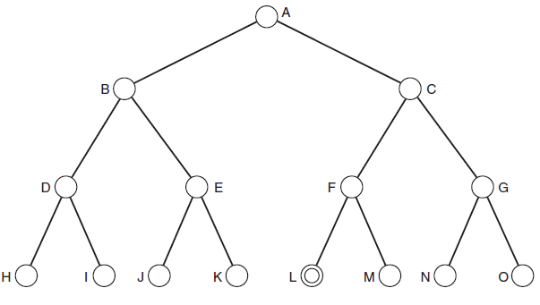

Slide 51
Using Heuristics for Search
Depth-first and breadth-first search were described as brute-force search methods because they do not employ any special knowledge of the search trees they are examining but simply examine every node in order until they happen upon the goal. This can be likened to the human being who is traversing a maze by running a hand along the left side of the maze wall.

Slide 52
Using Heuristics for Search
A heuristic evaluation function is a function that when applied to a node gives a value that represents a good estimate of the distance of the node from the goal. For two nodes m and n, and a heuristic function f, if f(m) < f(n), then it should be the case that m is more likely to be on an optimal path to the goal node than n. In other words, the lower the heuristic value of a node, the more likely it is that it is on an optimal path to a goal and the more sensible it is for a search method to examine that node.

Slide 53
Using Heuristics for Search
Typically, the heuristic used in search is one that provides an estimate of the distance from any given node to a goal node. This estimate may or may not be accurate, but it should at least provide better results than pure guesswork.

Slide 54
Informed and Uninformed Methods
A search method or heuristic is informed if it uses additional information about nodes that have not yet been explored to decide which nodes to examine next.
If a method is not informed, it is uninformed, or blind. In other words, search methods that use heuristics are informed, and those that do not are blind.
Best-first search is an example of informed search, whereas breadth-first and depth-first search are uninformed or blind.

Slide 55
Informed and Uninformed Methods
A heuristic h is said to be more informed than another heuristic, j, if:
h(node) ≥ j(node) for all nodes in the search space.
(In fact, in order for h to be more informed than j, there must be some node where h(node) > j(node). Otherwise they are as informed as each other.)
The more informed a search method is, the more efficiently it will search.

